Slide 1


Slide 2
AFFORDABLE AND CLEAN ENERGY
(The seventh goal of the sdg’s)
PREPARED: Ahmet Enes Topçu
NUMBER:150210310

Slide 3
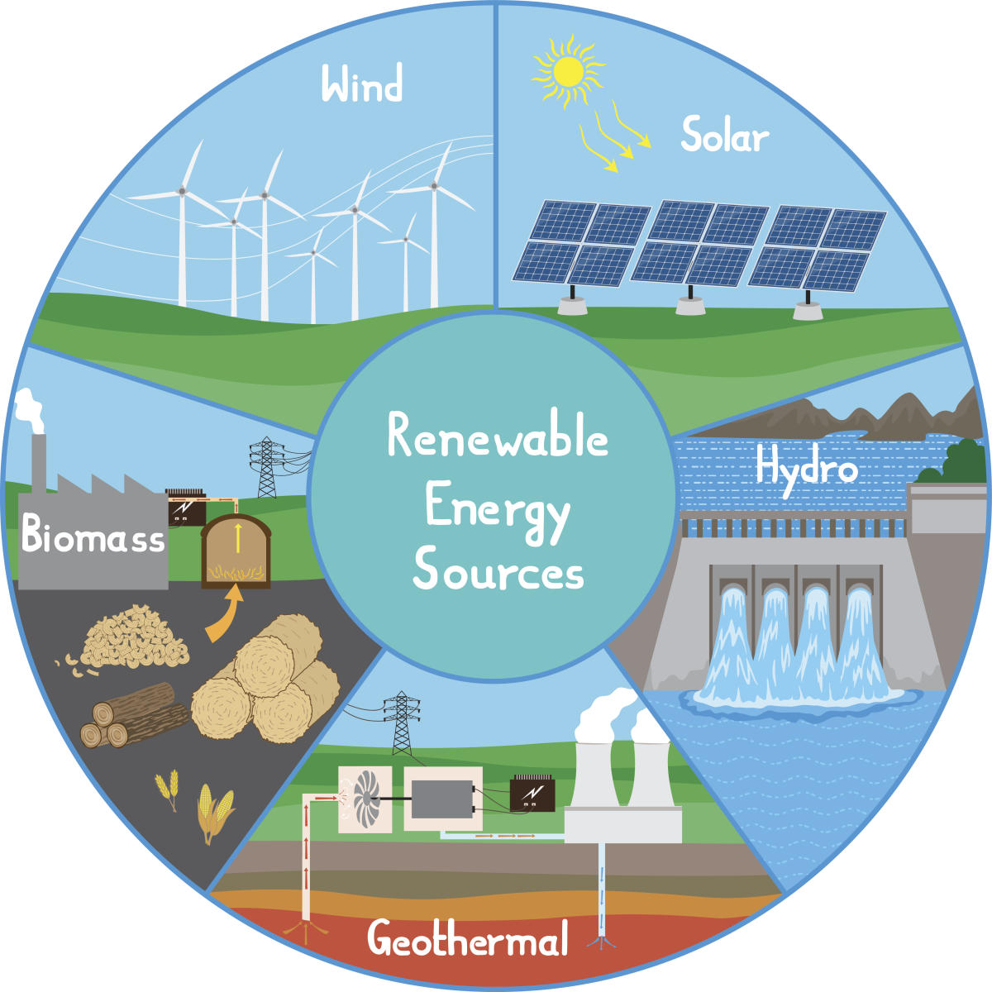
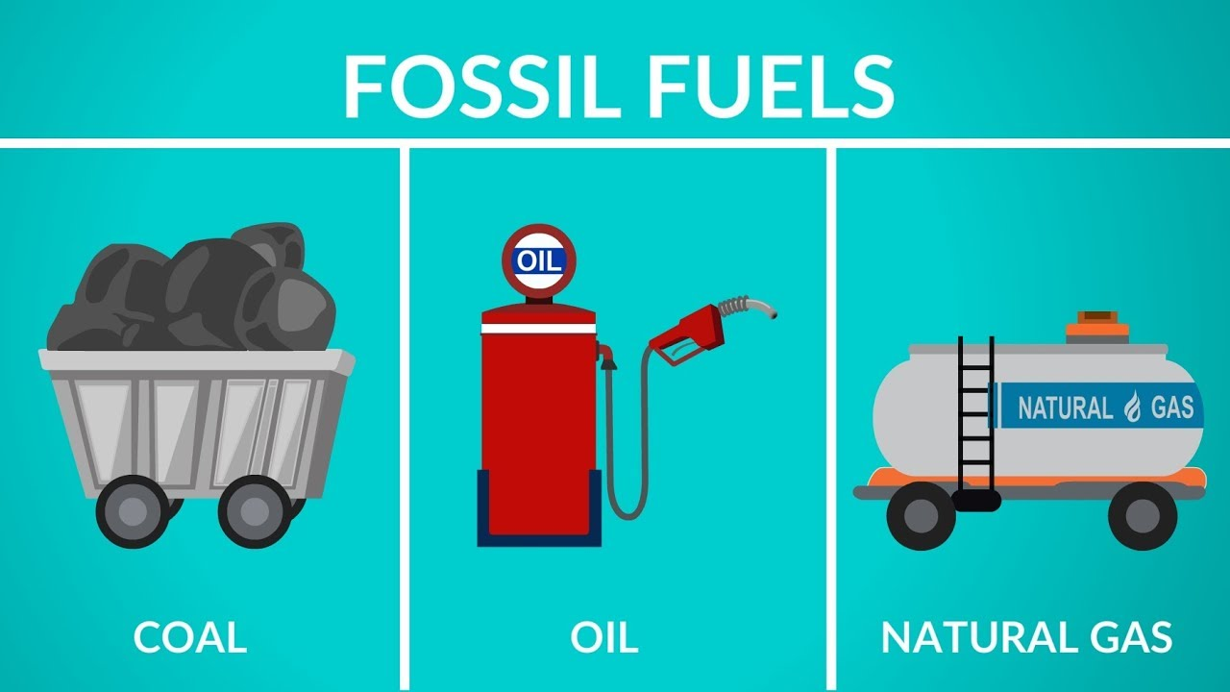
- Renewable energy - effıcıent, relıable, cheaper - Fossıl fuels - unsustaınable, harmful

Slide 4
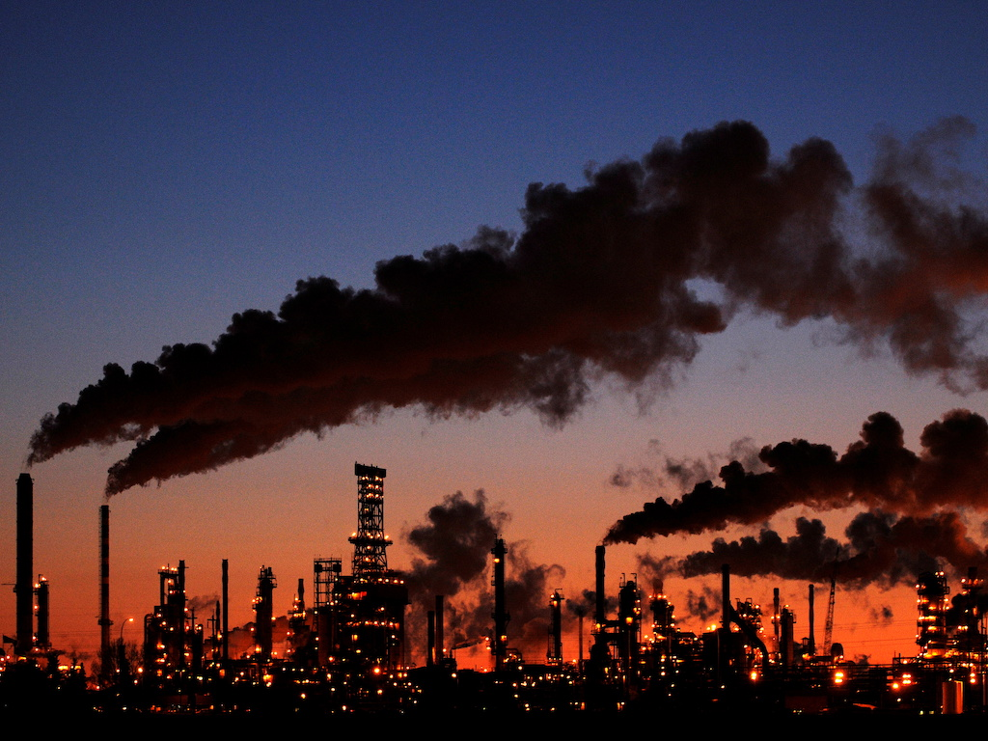
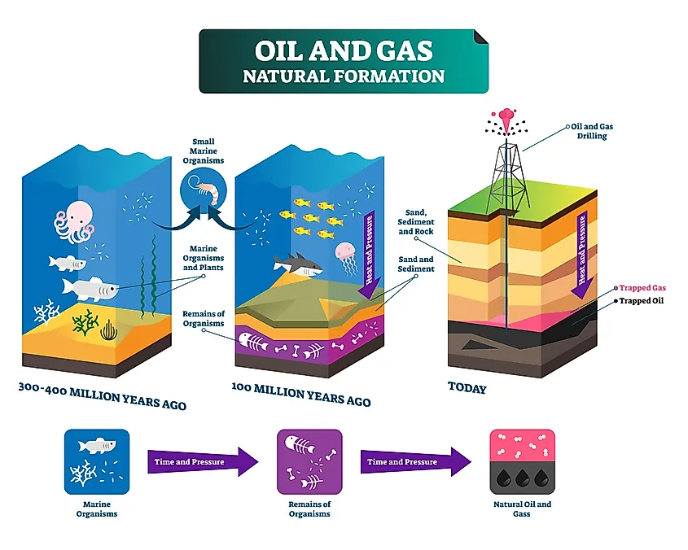
Why we stıll use fossıl fuels?

Slide 5
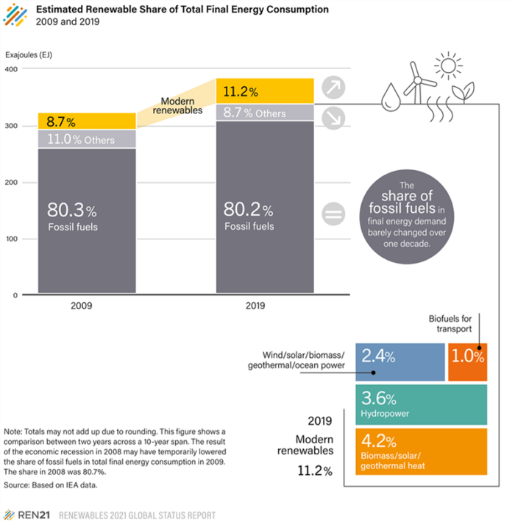
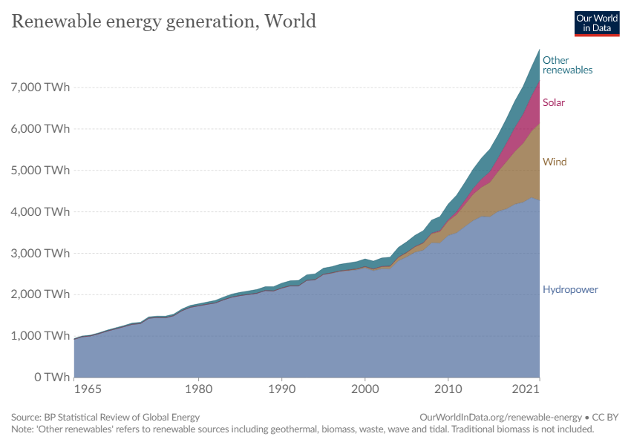
- New energy solutıons -clımate change -Total renewable energy consumptıon increased by a quarter between 2010 and 2019

Slide 6
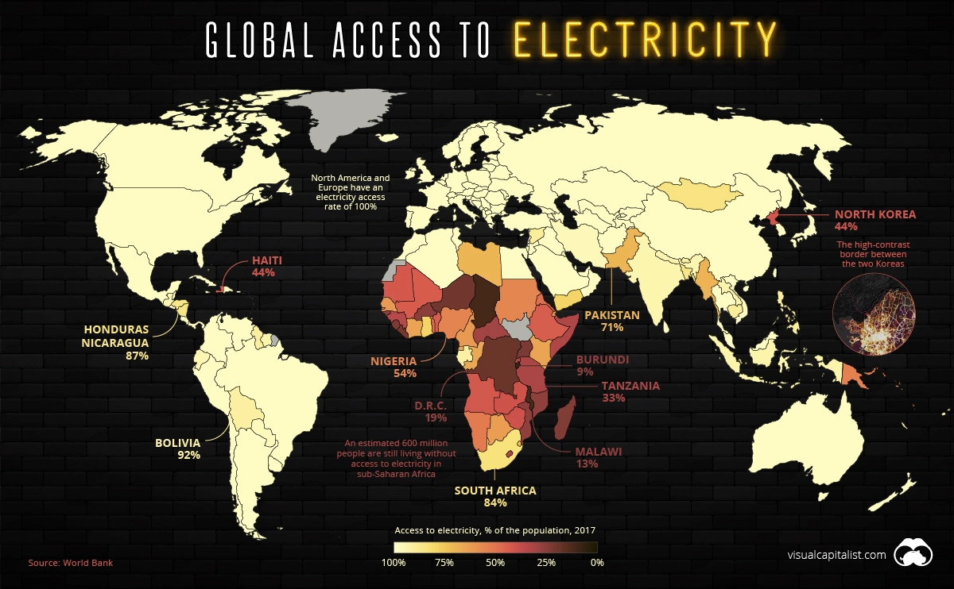
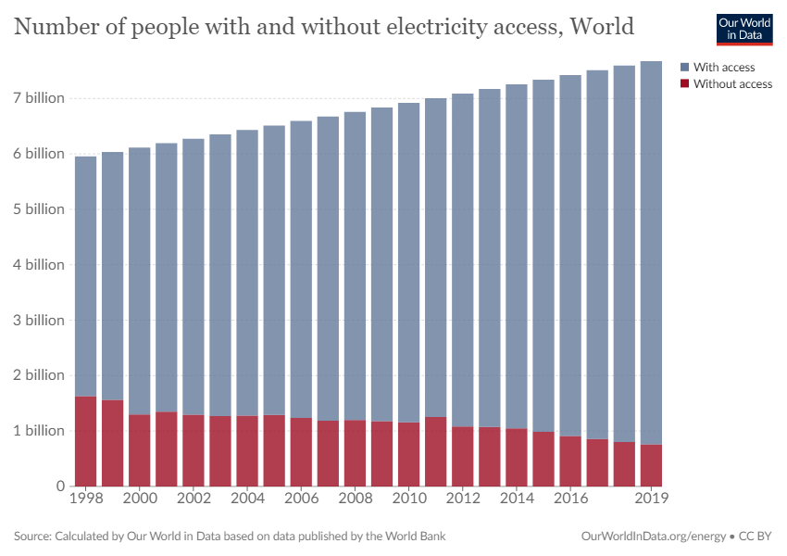
- 700 mıllıon people lıvıng ın the dark - Sub saharan afrıca

Slide 7
Unreasonable targets
Aim 1 - By 2030, ensure universal access to affordable, reliable and modern energy services
Aim 2 - By 2030, enhance international cooperation to facilitate access to clean energy research and technology, including renewable energy, energy efficiency and advanced and cleaner fossil-fuel technology

Slide 8
Reasonable aıms
Aim 3 - By 2030, it aims to increase the use of renewable energy all over the World
Aim 4 - By 2030, double the global rate of improvement in energy efficiency

Slide 9
UN secretary-general António Guterres said that “The good news is that the lifeline is right in front of us.”

Slide 10
António Guterres
“Without renewables, there can be no future.”

Slide 11
references
https://www.bbc.com/turkce/haberler-dunya-61810571
https://www.un.org/en/climatechange/raising-ambition/renewable-energy-transition?gclid=Cj0KCQjwhY-aBhCUARIsALNIC07V1_4lFXl5_mqI4Er565YZxbEpB4aI1o_MT0Bmltw24zHciLAjTNEaAhIqEALw_wcB
https://www.globalgoals.org/goals/7-affordable-and-clean-energy/

Slide 12


